Slide 1
Insertion Sort & Shellsort
By: Andy Le
CS146 – Dr. Sin Min Lee
Spring 2004

Slide 2
Outline
Importance of Sorting
Insertion Sort
  Explanation
  Runtime
  Advantage and Disadvantage
  Walk through example
Shell Sort
  History
  Explanation
  Runtime
  Advantage and Disadvantage
  Walk through example

Slide 3
Why we do sorting?
Commonly encountered programming task in computing.
Examples of sorting:
  List containing exam scores sorted from Lowest to Highest or from Highest to Lowest
  List containing words that were misspelled and be listed in alphabetical order.
  List of student records and sorted by student number or alphabetically by first or last name.

Slide 4
Why we do sorting?
Searching for an element in an array will be more efficient. (example: looking up for information like phone number).
It’s always nice to see data in a sorted display. (example: spreadsheet or database application).
Computers sort things much faster.

Slide 5
History of Sorting
Sorting is one of the most important operations performed by computers. In the days of magnetic tape storage before modern databases, database updating was done by sorting transactions and merging them with a master file.

Slide 6
History of Sorting
It's still important for presentation of data extracted from databases: most people prefer to get reports sorted into some relevant order before flipping through pages of data!

Slide 7
Insertion Sort
Insertion sort keeps making the left side of the array sorted until the whole array is sorted. It sorts the values seen far away and repeatedly inserts unseen values in the array into the left sorted array.
It is the simplest of all sorting algorithms.
Although it has the same complexity as Bubble Sort, the insertion sort is a little over twice as efficient as the bubble sort.

Slide 8
Insertion Sort
Real life example:
  An example of an insertion sort occurs in everyday life while playing cards. To sort the cards in your hand you extract a card, shift the remaining cards, and then insert the extracted card in the correct place. This process is repeated until all the cards are in the correct sequence.

Slide 9
Insertion Sort runtimes
Best case: O(n). It occurs when the data is in sorted order. After making one pass through the data and making no insertions, insertion sort exits.
Average case: θ(n^2) since there is a wide variation with the running time.
Worst case: O(n^2) if the numbers were sorted in reverse order.

Slide 10
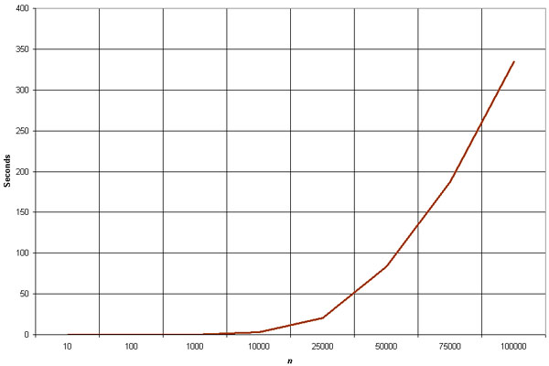
Empirical Analysis of Insertion Sort
The graph demonstrates the n^2 complexity of the insertion sort.
Source: http://linux.wku.edu/~lamonml/algor/sort/insertion.html

Slide 11
Insertion Sort
The insertion sort is a good choice for sorting lists of a few thousand items or less.

Slide 12
Insertion Sort
The insertion sort shouldn't be used for sorting lists larger than a couple thousand items or repetitive sorting of lists larger than a couple hundred items.

Slide 13
Insertion Sort
This algorithm is much simpler than the shell sort, with only a small trade-off in efficiency. At the same time, the insertion sort is over twice as fast as the bubble sort.

Slide 14
Advantage of Insertion Sort
The advantage of Insertion Sort is that it is relatively simple and easy to implement.

Slide 15
Disadvantage of Insertion Sort
The disadvantage of Insertion Sort is that it is not efficient to operate with a large list or input size.

Slide 16
Insertion Sort Example
Sort: 34 8 64 51 32 21
34 8 64 51 32 21
  The algorithm sees that 8 is smaller than 34 so it swaps.
8 34 64 51 32 21
  51 is smaller than 64, so they swap.
8 34 51 64 32 21

Slide 17
Insertion Sort Example
Sort: 34 8 64 51 32 21
8 34 51 64 32 21 (from previous slide)
  The algorithm sees 32 as another smaller number and moves it to its appropriate location between 8 and 34.
8 32 34 51 64 21
  The algorithm sees 21 as another smaller number and moves into between 8 and 32.
Final sorted numbers:
8 21 32 34 51 64

Slide 18
Shellsort
Founded by Donald Shell and named the sorting algorithm after himself in 1959.
1st algorithm to break the quadratic time barrier but few years later, a sub quadratic time bound was proven
Shellsort works by comparing elements that are distant rather than adjacent elements in an array or list where adjacent elements are compared.

Slide 19
Shellsort
Shellsort uses a sequence h₁, h₂, …, h_{t} called the increment sequence. Any increment sequence is fine as long as h₁ = 1 and some other choices are better than others.

Slide 20
Shellsort
Shellsort makes multiple passes through a list and sorts a number of equally sized sets using the insertion sort.

Slide 21
Shellsort
Shellsort improves on the efficiency of insertion sort by quickly shifting values to their destination.

Slide 22
Shellsort
Shellsort is also known as diminishing increment sort.
The distance between comparisons decreases as the sorting algorithm runs until the last phase in which adjacent elements are compared

Slide 23
Shellsort
After each phase and some increment h_{k}, for every i, we have a[ i ] ≤ a [ i + h_{k} ] all elements spaced h_{k} apart are sorted.
The file is said to be h_{k} – sorted.

Slide 24
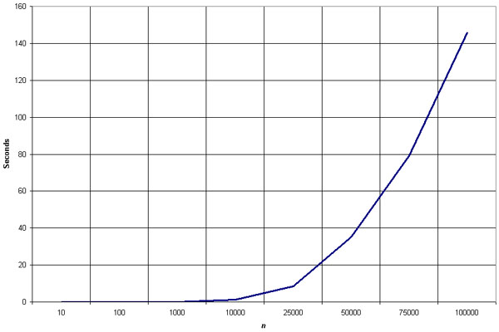
Empirical Analysis of Shellsort
Source: http://linux.wku.edu/~lamonml/algor/sort/shell.html

Slide 25
Empirical Analysis of Shellsort (Advantage)
Advantage of Shellsort is that its only efficient for medium size lists. For bigger lists, the algorithm is not the best choice. Fastest of all O(N^2) sorting algorithms.
5 times faster than the bubble sort and a little over twice as fast as the insertion sort, its closest competitor.

Slide 26
Empirical Analysis of Shellsort (Disadvantage)
Disadvantage of Shellsort is that it is a complex algorithm and its not nearly as efficient as the merge, heap, and quick sorts.
The shell sort is still significantly slower than the merge, heap, and quick sorts, but its relatively simple algorithm makes it a good choice for sorting lists of less than 5000 items unless speed important. It's also an excellent choice for repetitive sorting of smaller lists.

Slide 27
Shellsort Best Case
Best Case: The best case in the shell sort is when the array is already sorted in the right order. The number of comparisons is less.

Slide 28
Shellsort Worst Case
The running time of Shellsort depends on the choice of increment sequence.
The problem with Shell’s increments is that pairs of increments are not necessarily relatively prime and smaller increments can have little effect.

Slide 29
Shellsort Examples
Sort: 18 32 12 5 38 33 16 2
8 Numbers to be sorted, Shell’s increment will be floor(n/2)
* floor(8/2) ➔ floor(4) = 4
increment 4:
1 2 3 4
(visualize underlining)
18 32 12 5 38 33 16 2
Step 1) Only look at 18 and 38 and sort in order ;
18 and 38 stays at its current position because they are in order.
Step 2) Only look at 32 and 33 and sort in order ;
32 and 33 stays at its current position because they are in order.
Step 3) Only look at 12 and 16 and sort in order ;
12 and 16 stays at its current position because they are in order.
Step 4) Only look at 5 and 2 and sort in order ;
2 and 5 need to be switched to be in order.

Slide 30
Shellsort Examples (con’t)
Sort: 18 32 12 5 38 33 16 2
Resulting numbers after increment 4 pass:
18 32 12 2 38 33 16 5
* floor(4/2) ➔ floor(2) = 2
increment 2:
1 2
18 32 12 2 38 33 16 5
Step 1) Look at 18, 12, 38, 16 and sort them in their appropriate location:
12 38 16 2 18 33 38 5
Step 2) Look at 32, 2, 33, 5 and sort them in their appropriate location:
12 2 16 5 18 32 38 33

Slide 31
Shellsort Examples (con’t)
Sort: 18 32 12 5 38 33 16 2
* floor(2/2) ➔ floor(1) = 1
increment 1:
1
12 2 16 5 18 32 38 33
2 5 12 16 18 32 33 38
The last increment or phase of Shellsort is basically an Insertion
Sort algorithm.

Slide 32
Additional Online References
Spark Notes (From Barnes & Noble):
  http://www.sparknotes.com/cs/

Slide 33
The End

